Slide 1

Software Engineering
Software Project Management, Architecture & Design
Software Project Management
Department of Computer Science and Engineering
Acknowledgement: Dr. Phalachandra HL, Prof. Anand MS, authors of the prescribed textbooks and materials sourced online.

Slide 2

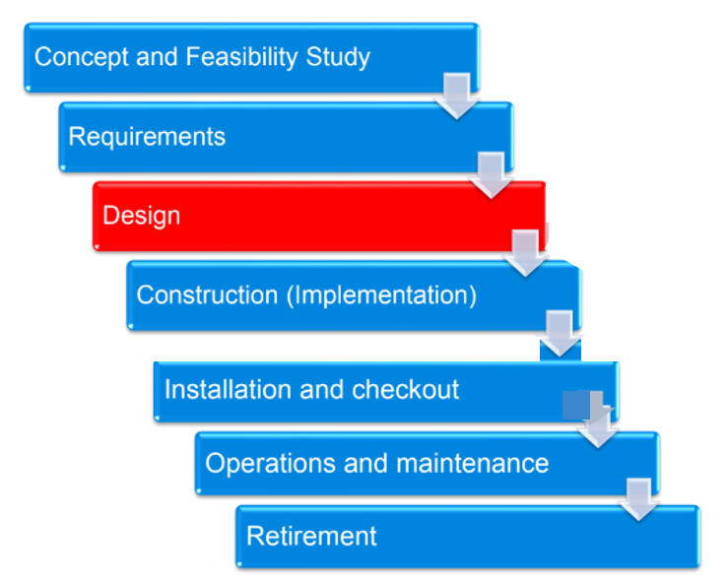
Context of Software Design
Architectural Design
Architectural design describes
how software is decomposed
and organized into components
(the software architecture) [IEEE
1471-00]
Detailed Design
Detailed design describes the
specific behavior of components
identified during architectural
design

Slide 3
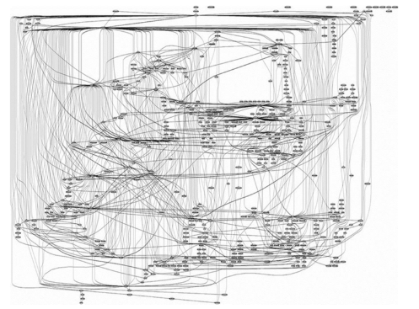
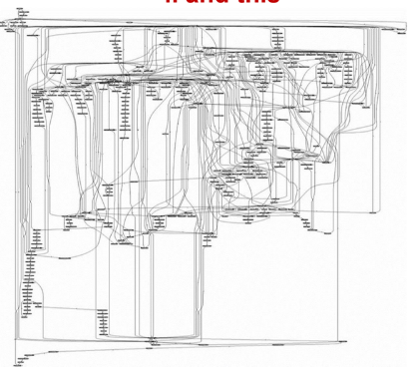
Guess what these are!
Call graph of Microsoft IIS Web server
Apache Web server

Slide 4
Takeaway
What do you think is the takeaway from the previous slide?
Well written software will definitely be more maintainable

Slide 5

Think about it!
What might be the similarities between mastering chess and mastering the software development? Can you think of some similarities?
Learning the rules
Learning the principles (relative weight of certain chess pieces; generic/object oriented programming)
Study game patterns of other masters; Study the architectural and design patterns of other masters
The patterns studied must be understood and applied repeatedly

Slide 6

Software Architecture
What is Software Architecture?
It is the top level decomposition into major components together with a characterization of how these components interact
Software architecture of a computing system can be
▪ Used for communication among stakeholders
▪ a blueprint for the system and project under development
▪ Used for negotiations and balancing of functional and quality goals happen during architecture

Slide 7

Importance of Software Architecture
Architecture manifests the earliest set of design decisions
▪ Constraints on implementation
▪ Dictates organizational structure
▪ Inhibits or enable quality attributes and supports WBS
Supports reuse at architectural system level
Helps in work breakdown and structures the development
▪ Reduces risk and can enable cost reduction during product development
Changes to architecture is expensive in the later phases of SDLC

Slide 8
Characteristics of Software Architecture
Addresses variety of stakeholder perspectives
Realizes all of the use cases and scenarios envisaged for the problem
Supports Separation-of- Concerns
Quality driven
Recurring styles
Conceptual integrity

Slide 9
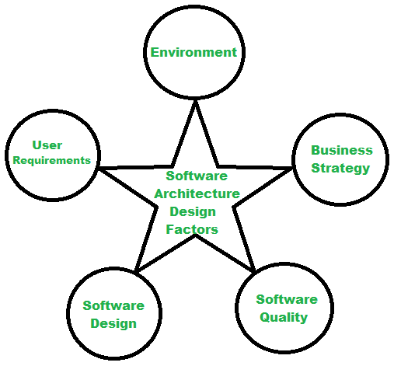
Software Architecture Design Factors
new content

Slide 10
Factors that influence Software Architecture
Functional requirements
Data Profile
Audience
Usage characteristics
Business priority
Regulatory and Legal obligations
Architectural standards
Dependencies and Integration
Cost constraints
Initial state
Architect, staff background
and the skill level
Technical and organizational
environment
Technology constraints
Type of user experience planned

Slide 11
Architect
Software Architect is a role within the software development organization structure, who makes high level design choices and dictates technical standards, including software coding standards, tools and platforms
An architect has
Distinct role in
Project
Broad training &
Extensive
experience
Deep understanding
of domain

Slide 12
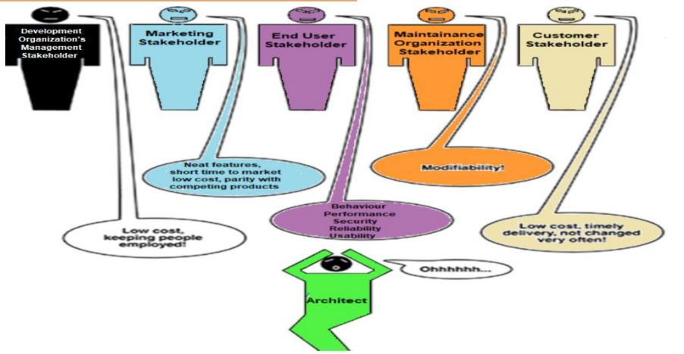
Role of an architect

Slide 13
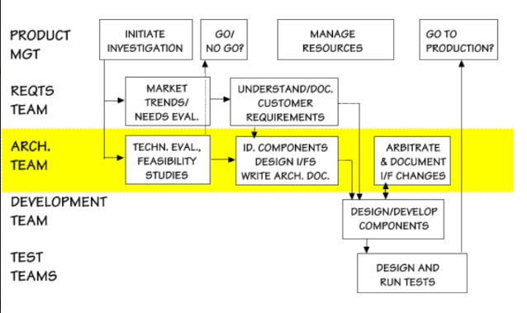
Components of different teams

Slide 14
Architectural views, styles & patterns
Architectural View
Views represent ways of describing the Software Architecture, enabling the system to be viewed by different stakeholders in perspectives of their interest.
IEEE standard 1471
Ex: UI View, Process View
Architectural Styles
Demonstrates how the subsystems or elements are organized or structured
It is a way of organizing code
Ex: Pipe & filters, Client-Server, Peer-to-Peer
Architectural Pattern
Is a known or a proven solution to the architectural problem of structuring and functioning of the subsystems which has been used earlier and is know to work for the problem scenario
Ex: MVC separating UI from the rest

Slide 15
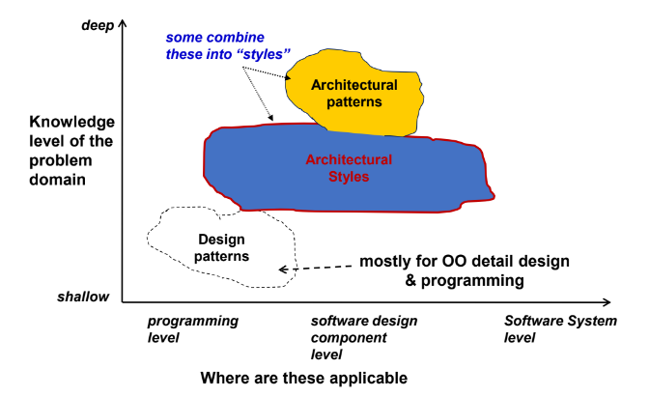
Combined view

Slide 16
THANK YOU
Software Project Management
Department of Computer Science and Engineering
‹#›

